Slide 1
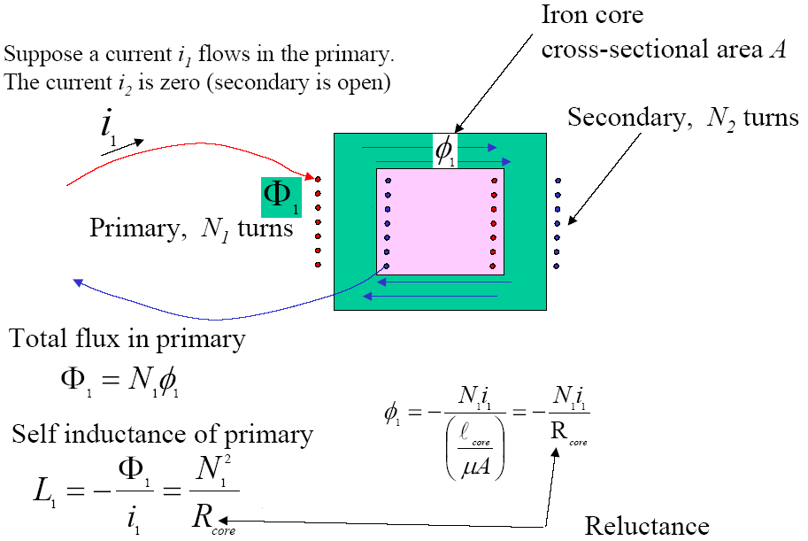
TRANSFORMER MODELING
From Ampere’s law

Slide 2
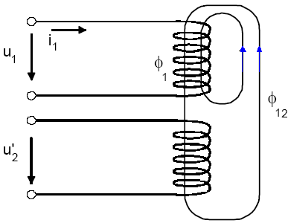
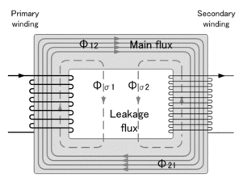
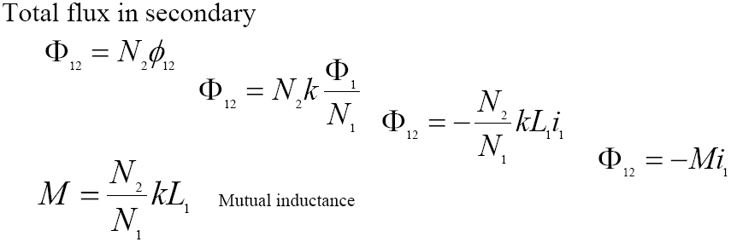
TRANSFORMER MODELING
Let φ₁₂ be the flux in each of the loops in the secondary resulting from the current i₁ in the primary.
Write: φ₁₂ =k φ ₁
Where k is a flux coupling coefficient. k < 1 but in good transformer k ≈1 .
φ ₁ = Ф₁/N₁

Slide 3
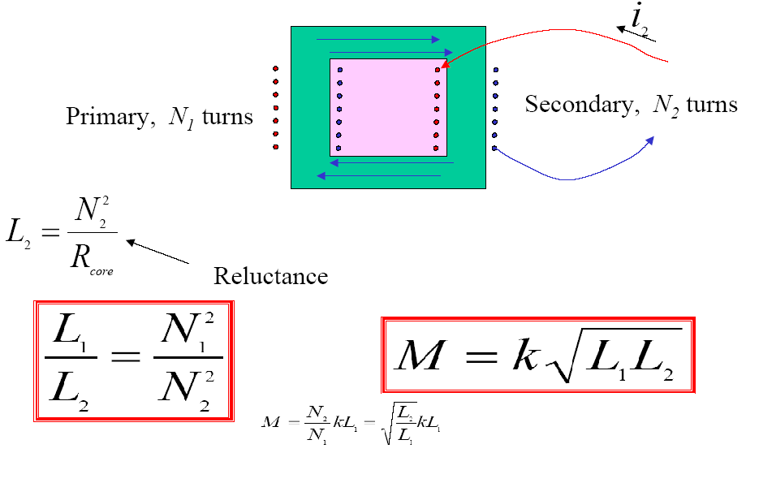
TRANSFORMER MODELING

Slide 4
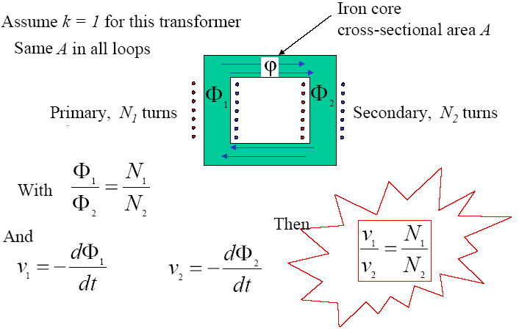
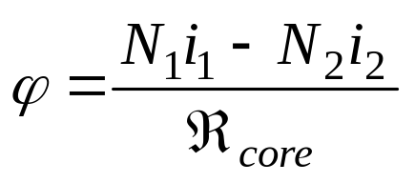
TRANSFORMER MODELING voltage transformation
A mutual flux links the two coils:

Slide 5
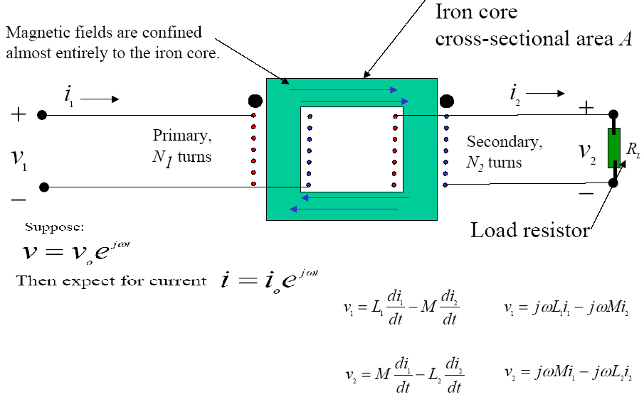
TRANSFORMER MODELING current transformation

Slide 6
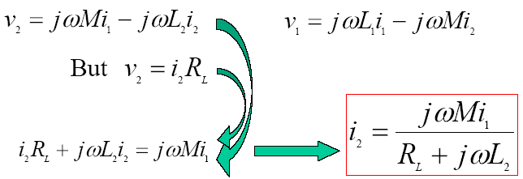
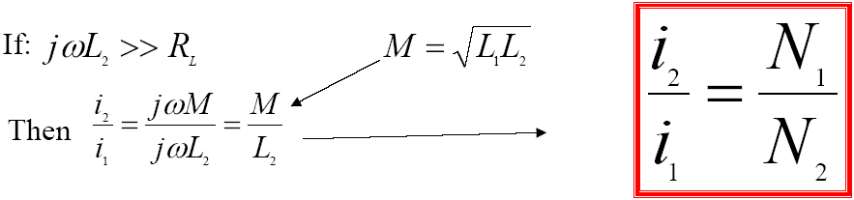
TRANSFORMER MODELING current transformation

Slide 7
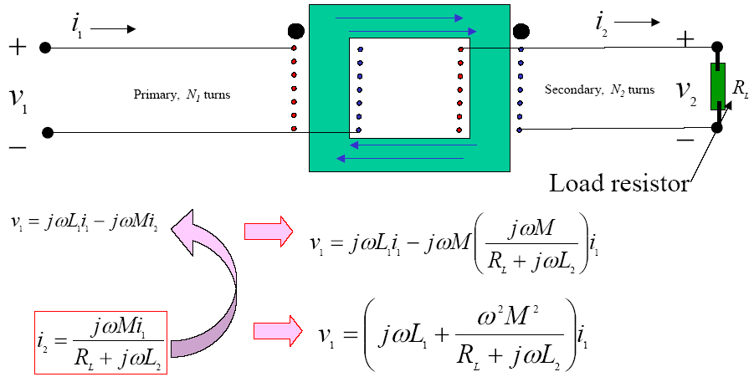
TRANSFORMER MODELING impedance transformation

Slide 8
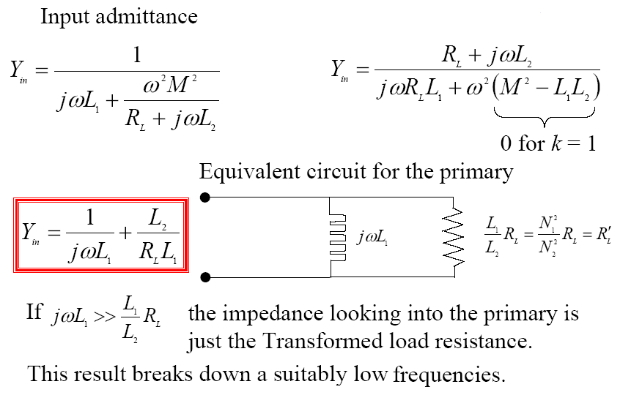
TRANSFORMER MODELING impedance transformation

Slide 9
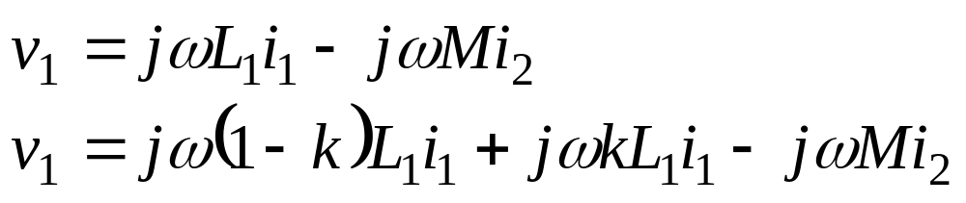
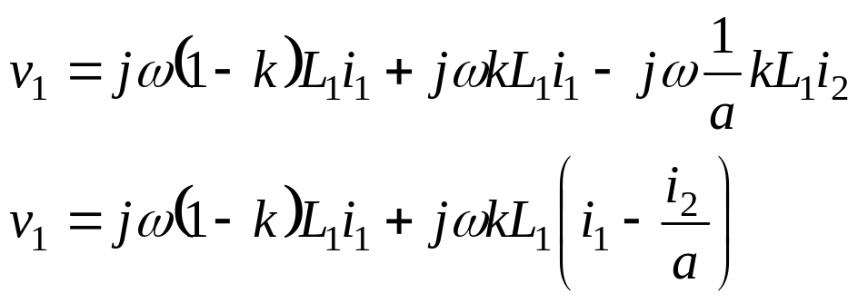
TRANSFORMER MODELING
Equivalent circuit
Let N₁/N₂=a , then M=(N₂/N₁)kL₁=(1/a)kL₁

Slide 10
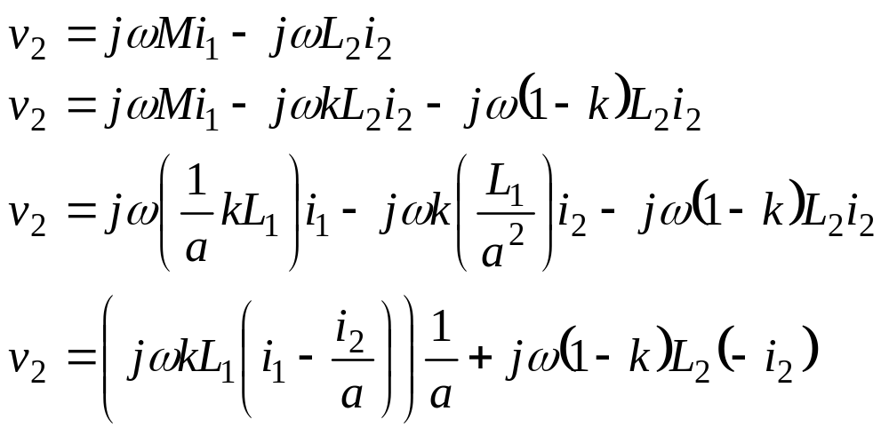
TRANSFORMER MODELING
Equivalent circuit
For the secondary:

Slide 11
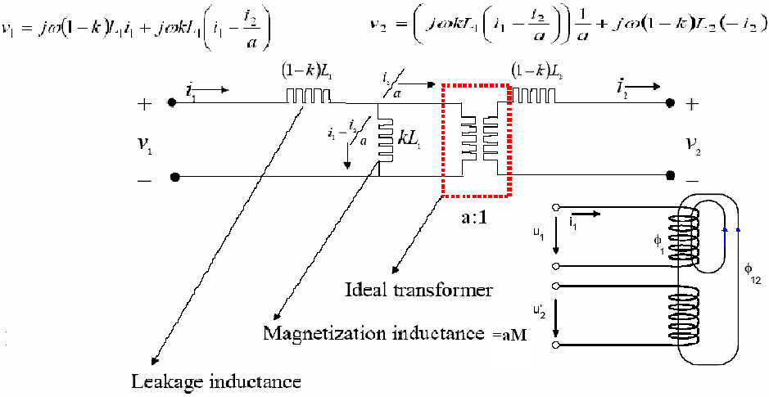
TRANSFORMER MODELING
Equivalent circuit

Slide 12
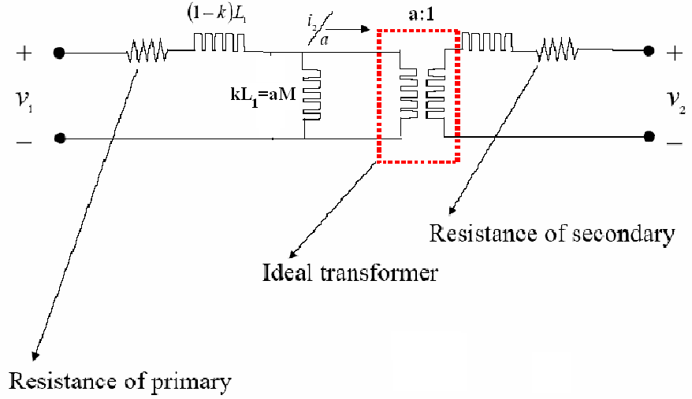
TRANSFORMER MODELING
Equivalent circuit

Slide 13
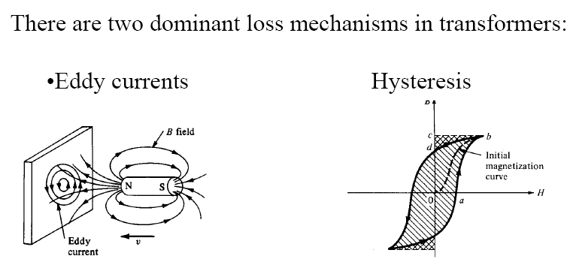
Transformer Losses
Both depend upon magnetic properties of the materials used to construct the core of transformer and its design.

Slide 14
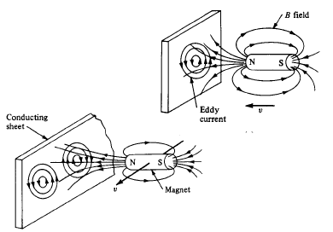
Transformer Losses
Eddy Currents
The changing magnetic field on the conducting sheet will induce current in the sheet. These currents are known as Eddy currents. Energy loss occurs through Joule’s heating.

Slide 15
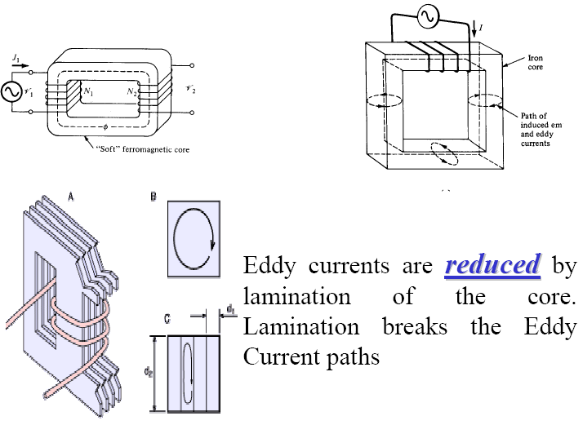
Transformer Losses
Eddy Currents

Slide 16
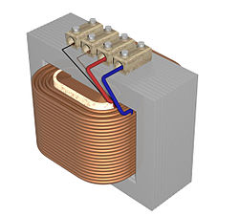

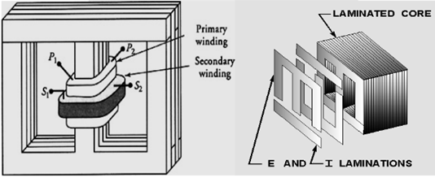
Transformer Losses

Slide 17
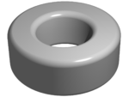
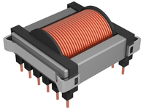
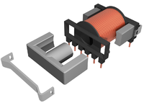
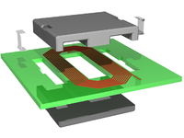
Transformer Losses
High frequency transformer cores

Slide 18
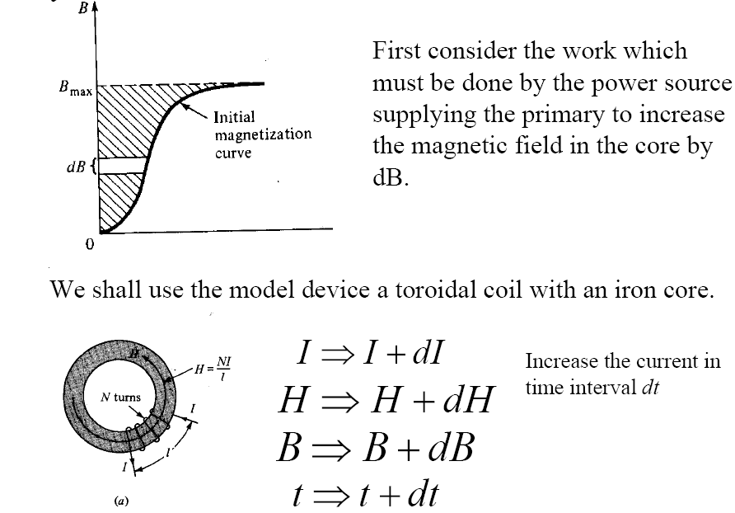
Transformer Losses
Hysteresis

Slide 19
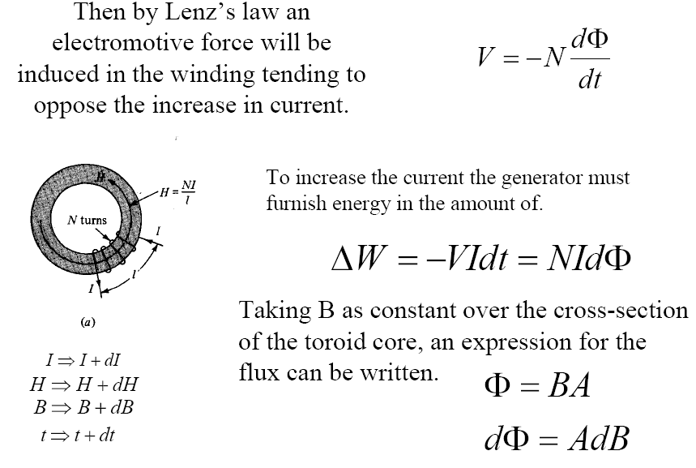
Transformer Losses
Hysteresis

Slide 20
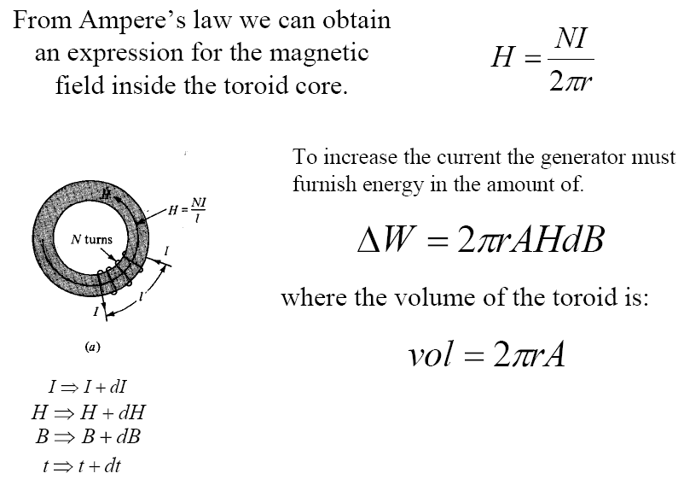
Transformer Losses
Hysteresis

Slide 21
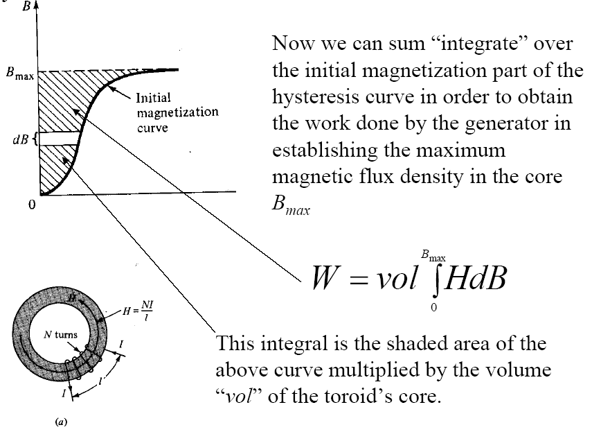
Transformer Losses
Hysteresis

Slide 22
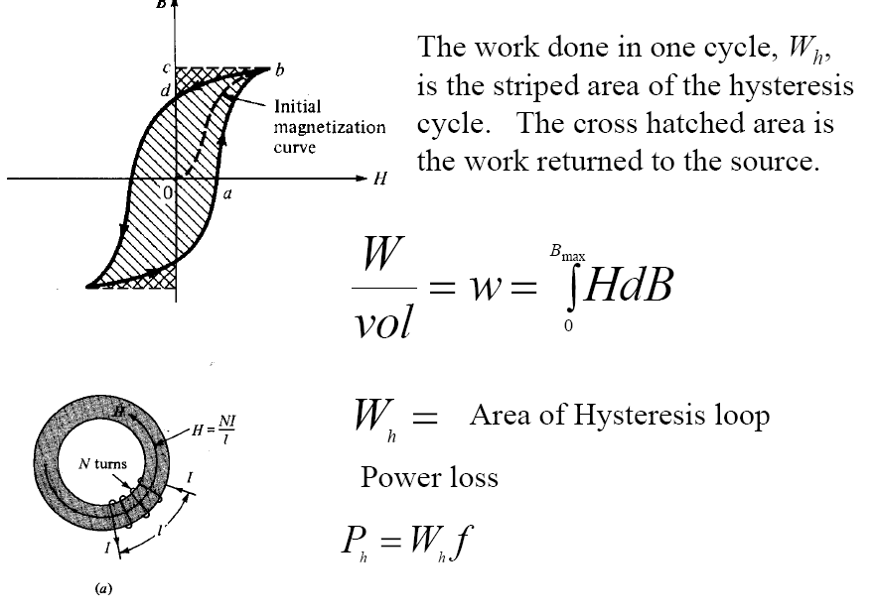
Transformer Losses
Hysteresis

Slide 23
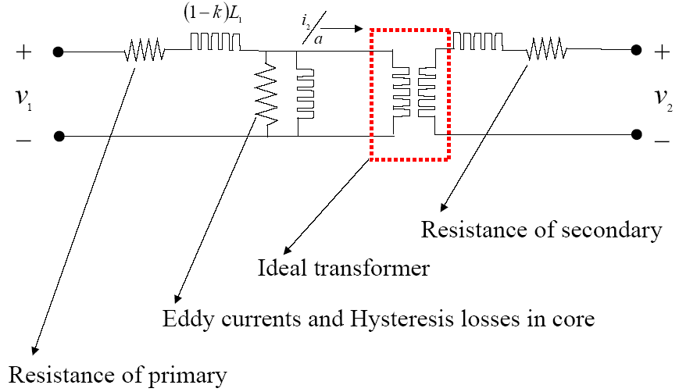
Transformer Modeling
Equivalent circuit

